Slide 1
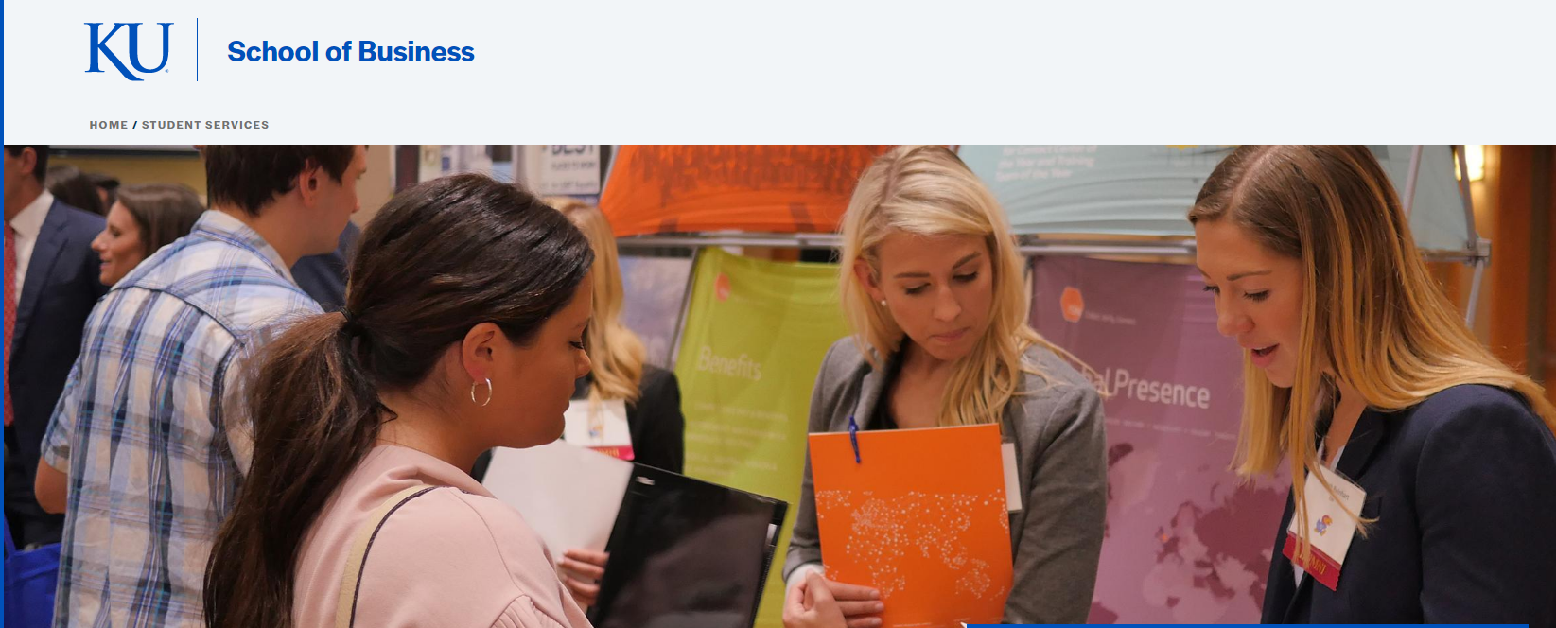
Statistical Analysis of Career Services 2021
Authors: Sara Galapo, Anna Stovall, and Stephanie Schmitz

Slide 2
PROBLEMS
Lack of retaining repeat appointments
Lack of new student involvement
Lack of advising expertise across all majors, especially specialty majors
Lack of diverse student outreach/opportunity (JCCC, foreign, transfer, non-white)
Lack of career navigation → each student needs to have a guided plan

Slide 3

STUDENT FEEDBACK
HELP ME WITH:
Resume Review
Job Search
Learn about Career Paths for multiple Fields
Unsure which path to choose for financial stability
Unsure of the career options within major (lots of flexibility)
Major or Minor change or add ons
Review Finance Scholars application, BHP application
Mock Interview/ Interview Prep Materials
Offer negotiations
*not a data analytics review: just my quick observation based on counseling comments.
Notes:
STUDENT FEEDBACK for COUNSELING SERVICES
Students need guidance. They need a mentor to guide them step by step.
** LinkedIn needs to be added to career services. It is vital to expanding their network beyond KU.
Do pulls on student goal to stay local, move to CO,TX,AZ,etc. or abroad work. → this would be helpful to know starting with BUS 210 students on day one, where they want to live because when you apply for work, location is the first thing the application asks. Saying anywhere hurts applicants.
You may be their only point of reference for business help. Maybe their family are all biologists or did not go to college, foreign students, transfers from JCCC, or are the oldest sibling. Polls on this would be helpful, but either way, assume students do not have addition help and rely upon your services.

Slide 4
THE FACTS
Only 5.18% of students interact with Exploring Careers Events. | Stephanie manages the majority of online appts. | Nikki conducts the most counseling appointments, both in person and virtual. | 541 students attended an exploratory career event for their major. Currently, not offered. Must come back.
2796 Students are in the School of Business. 17% of which are BUS 210 students. | Specialty majors are not getting the attention and guidance they need across all events, appts, and counseling services. | 32.3% of the Business Student Body scheduled appointments in 2021. Target Goal: 595 Advising meetings per advisor (5) = one advising appt/student annually → 3 appts/day | Company specific career events are offered with 145 students attending. Compared to 2018, only one event for P&G took place. 38 attended. Almost 4X of increased participation.

Slide 5
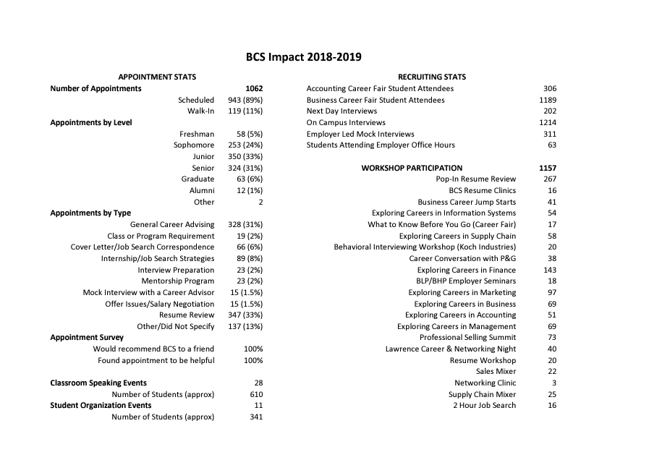
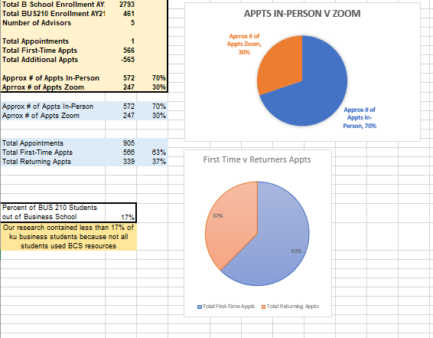

Comparing BCS Impact from 2018-19 to 2021
In 2018, 89% Scheduled and 11% Walk-in with 1062 Total Appts.
In 2021, 70% In-person 30% Zoom with 905 Total Appts.

Slide 6
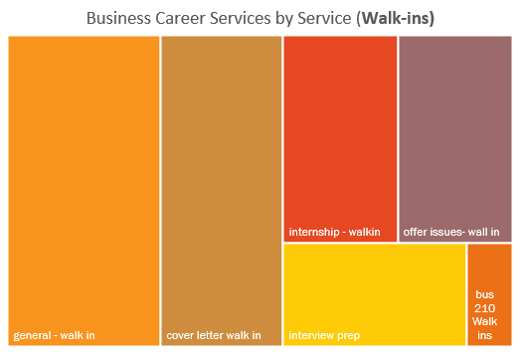
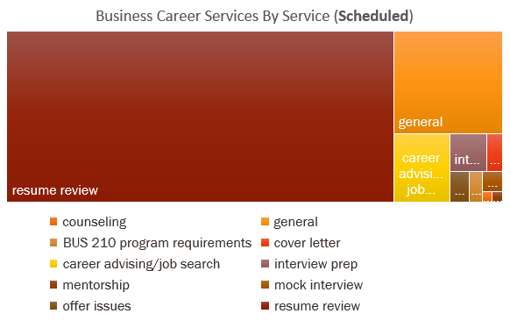
Lobby Kiosk Swipes
Cntl+ Click Here to go to Solution
1-877-446-7746
Notes:
GENERAL and RESUMES REVIEWS
People don’t know what you do nor where to start.
Advertising needs to be spent on showcasing the range of services BCS provides.
Resumes is only one aspect of your services, but students do not know this.
Put a retractable banner, listing all services in the lobby/check in area so students can see all options.
$150 to get a stand still body height sign listing all services. “4 Imprint” sells them.
Do not forget, you are mentorship for so many students that have no idea with path in business to take because is business there are so many great options. It’s BCS job to help each student narrow it down. Meaning, it takes time to get to know each student and their goals.
Holistic approach is needed.

Slide 7
Kiosk Traffic Flow
Notes:
OCTOBER was taken out of DROP-IN advising and 8AM on WALKIN was taken out of data because of human input error of 500+ resumes entered at the same time by human.
** SYSTEM NEEDS TO BE CREATED SO THAT THIS IS IMPOSSIBLE TO DO.

Slide 8
October has widest range of majors: Bus Admin, FIN, MKMT, Supply Chain
621 students in month of October.
Notes:
Remember, data is skewed because there are more ACCT and FIN majors than any other major.

Slide 9
Online Appointments
Nikki/Nikita data not present
Stephanie manages the majority of returning students. She reaches the most Business Administration and Business Analytics majors with almost all business majors, plus outside fields. Her students are majority Seniors. | Marketing Senior Students attend most online counseling appts.
Most common returning majors are Marketing, Finance, Business Administration, and Business Analytics | Jennifer manages the most Marketing students. Jolene manages the most Finance majors.

Slide 10
Jolene and Stephanie are most requested for online appts.

Slide 11
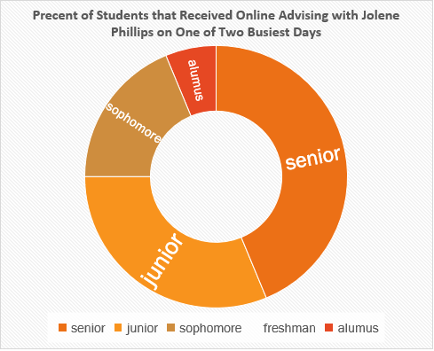
Online Appointments
At 2PM, Jolene meets with IST students the most: 31% of the time at 2PM. She manages seniors and juniors the most and no freshmen during online appts.
At 10AM, her busiest time, she helps Marketing seniors the most. Along with two BSAN students and one alumni.
Notes:
The busiest time is gathered across multiple months throughout school year.

Slide 12
Notes:
Change Hours to 9AM to 3PM for better use of time and effort
Schedule more advisors during 10AM and 2PM
90 students use online advising. 90 out of 2973 is not great. Needs improvement or change.
Senior rush at 10AM. Juniors and Sophomores at 11AM and 2PM
Seniors and Alumni use this platform the most.
Bus Admin, Marketing, FIN majors use this platform the most. 3 out of 9 majors.

Slide 13
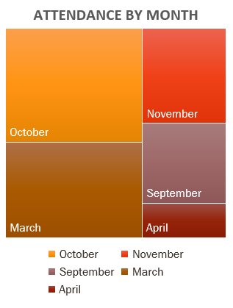
Exploring Careers – 10 Events
145 students attended one or more events. 5.19% of Business student body. | October saw the most attendance at 33.79% of 145 students in attendance. Followed by March.
43% of events are attended by returning students. And 57% are attended by first time event goers. | Finance and Accounting Majors and Minors had the highest number of attendances across all events.
Juniors take the lead in attendance at 29.7%. Followed by 23.4% of sophomores and freshmen. | Non-Business minors and Business Administration majors takes second place for attendance.

Slide 14
BUS 210

Slide 15
BUS 210

Slide 16
Parker Dewey & Quinncia

Slide 17
Advisors Report
*Blank: means no advisor specifically requested
Nikki is consistently requested across all times with most requests.

Slide 18
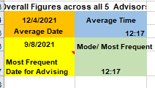
Advising Report
Most people get advising in the start and end of the semester.
Missing the mark with Supply Chain entirely
Nikki sees most students. Nikki and Nikkita see 12.5% more students than the other advisors.

Slide 19
ACCT/BUS Career Fair
Notes:
Supply chain seems to be left out in every data chart made including career fair events. Stem, however, is making an appearance in business career fairs. Mainly consist of Computer science, biology, physics, and pre-law majors. Perhaps, more major integration is needed or an entirely separate stem and business career fair which includes BSAN, IST, and entire STEM field: Science academia and engineering school.

Slide 20
Business Career Fair
Notes:
*skewed by 95 students because the system for tracking majors and minors are in the same column/cell which makes excel unhappy and my job harder. Next time, make two separate entries for major and minor fields. Many business studies are across two schools i.e liberal arts and business or pre-med, law-law and business.

Slide 21
Business Student Body 210

Slide 22
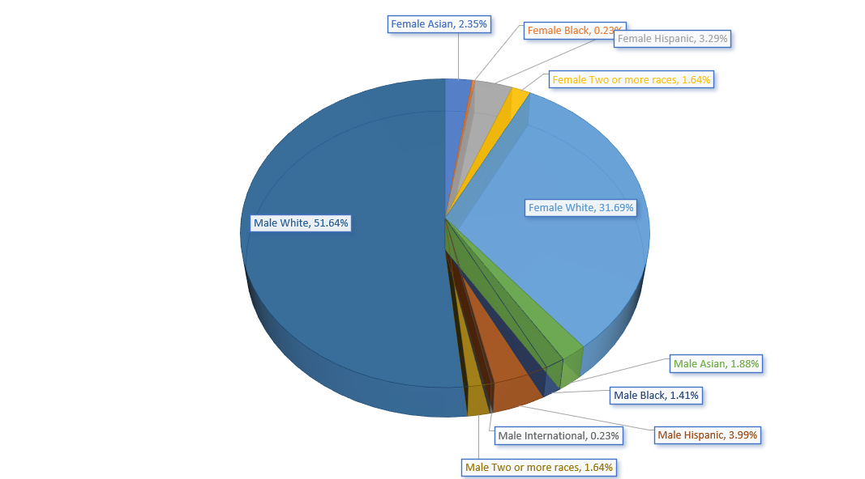
Notes:
THIS IS NOT DIVERSE AT ALL.
DO NOT IGNORE THIS.
STARTS WITH HIGH SCHOOLS.

Slide 23
PROBLEMS
Refresher
Lack of retaining repeat appointments
Lack of new student involvement
Lack of advising expertise across all majors, especially specialty majors
Lack of diverse student outreach/opportunity (JCCC, foreign, transfer, non-white)
Lack of career navigation → each student needs to have a guided plan

Slide 24
SOLUTIONS
ADVISORS
ADVERTISING
Informed training of all opportunities for each major, especially specialty majors
Require Follow up appts. With all students
Require all students to take a career placement test before meeting careerleader.com
10 e points for attending first advising appt. 0.5 - 1 pt. going forward.
Retractable Banner in BSchool
Canva Flyers
Foot Decals Leading to BCS
Coffee Chit Chat w Advisor Target women
Advertisements on HireJayhawk for BCS
Start BCS ad emails with title “FREE”
Tik Tok @kubuscareer

Slide 25
STUDENT FEEDBACK
HELP ME WITH:
Resume Review
Job Search
Learn about Career Paths for multiple Fields
Unsure which path to choose for financial stability
Unsure of the career options within major (lots of flexibility)
Major or Minor change or add ons
Review Finance Scholars application, BHP application
Mock Interview/ Interview Prep Materials
Offer negotiations
*not a data analytics review: just my quick observation based on counseling comments.
Notes:
STUDENT FEEDBACK for COUNSELING SERVICES
Students need guidance. They need a mentor to guide them step by step.
** LinkedIn needs to be added to career services. It is vital to expanding their network beyond KU.
Do pulls on student goal to stay local, move to CO,TX,AZ,etc. or abroad work. → this would be helpful to know starting with BUS 210 students on day one, where they want to live because when you apply for work, location is the first thing the application asks. Saying anywhere hurts applicants.
You may be their only point of reference for business help. Maybe their family are all biologists or did not go to college, foreign students, transfers from JCCC, or are the oldest sibling. Polls on this would be helpful, but either way, assume students do not have addition help and rely upon your services.

Slide 26




Slide 27

DISCLAIMER
Please have a third-party of analysts review our work as we are still students and make mistakes occasionally.
Thank you for attending this meeting. Let’s do some good with these numbers.

